Slide 1

Milestone 2: Reproducibility
Software Engineering
for AI Enabled Systems
Students: Basile Andrea, Iacovazzi Antonio Raffaele, Lorusso Roberto, Pomponio Emanuele

Slide 2
Why reproducibility?
Reproducibility is essential for an experiment in any domain.
The authors of an experiment have to document every aspect of it in order to make it possible for other people to do it again in the same conditions and verify if they obtains the same results.
This obviously also applies in the machine learning domain.

Slide 3
Reproducibility in Machine Learning
Three main technologies: data versioning, pipeline and experiment tracking.
Using data versioning we can track and store changes in data over time, this allows to load the proper data used in a certain experiment done at time t.
Using a pipeline we can establish an unique sequence of actions in order to reproduce the experiment without any variation in the order of steps.
Using experiment tracking we can store the results of any experiment, usually we want to store the hyperparameters and the metrics of a certain run.

Slide 4
Technologies: DVC + MlFlow + DagsHub
In this project DVC is used for data versioning and for the implementation of the pipeline, then MLFlow is used for experiment tracking.
Data and experiments results need to be stored somewhere, for this job DagsHub has been adopted both as storage for DVC and as hub for MlFlow having an unique place for our reproducibility tasks giving also up to 10 GB in its free plan.

Slide 5
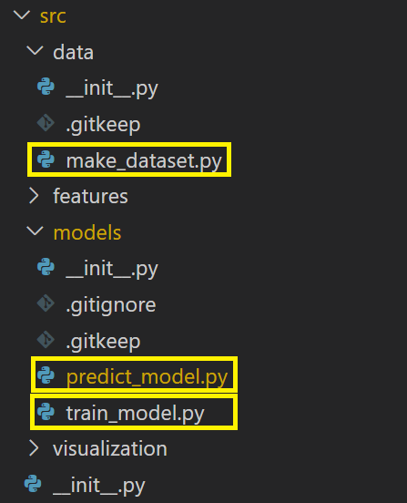
Intermediate Steps: Code Restructuring
In order to conform to the standard structure of a machine learning pipeline, we moved the original code from the original ipynb notebook to three different python files, corresponding to the three main steps of the pipeline.

Slide 6
DVC: Setting up the Pipeline
The dvc.yaml is divided into three stages, corresponding to the phases of our machine learning pipeline:
Data preparation stage
Training stage
Evaluation stage
To each stage is associated:
A python file, containing the code to be executed in that phase.
The dependencies required for the execution of the stage.
The output files generated at the end of the stage.

Slide 7
DVC: Prepare-Dataset Stage
In this stage we prepare the data for further training and evaluation phases.
Below we illustrate the execution steps for this stage:
Select a set of classes from the original dataset.
Extract train, validation and test set from the previuos selected classes (further details can be found at data card link).

Slide 8
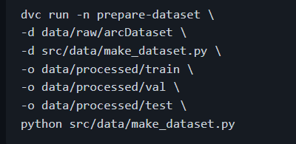
DVC: Prepare-Dataset Stage
In order to add the stage to dvc.yaml file we execute the following command:

Slide 9
DVC: Training Stage
In this stage we train the model, saving it inside the two files:
model.json: contains the model structure.
model.h5: contains the learned weights.
Below we illustrate the execution steps for this stage:
Model building.
Preprocessing of images (further details can be found at preprocessing).
Model training.
Saving of the model's parameters.

Slide 10
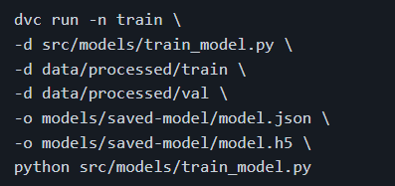
DVC: Training Stage
In order to add the stage to dvc.yaml file we execute the following command:

Slide 11
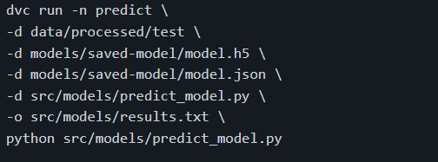
DVC: Predict Stage
In this stage we evaluate the model, making predictions on the test set, giving as output:
src/models/results.txt: contains the evaluation results for the accuracy.
In order to add the stage to dvc.yaml file we execute the following command:

Slide 12
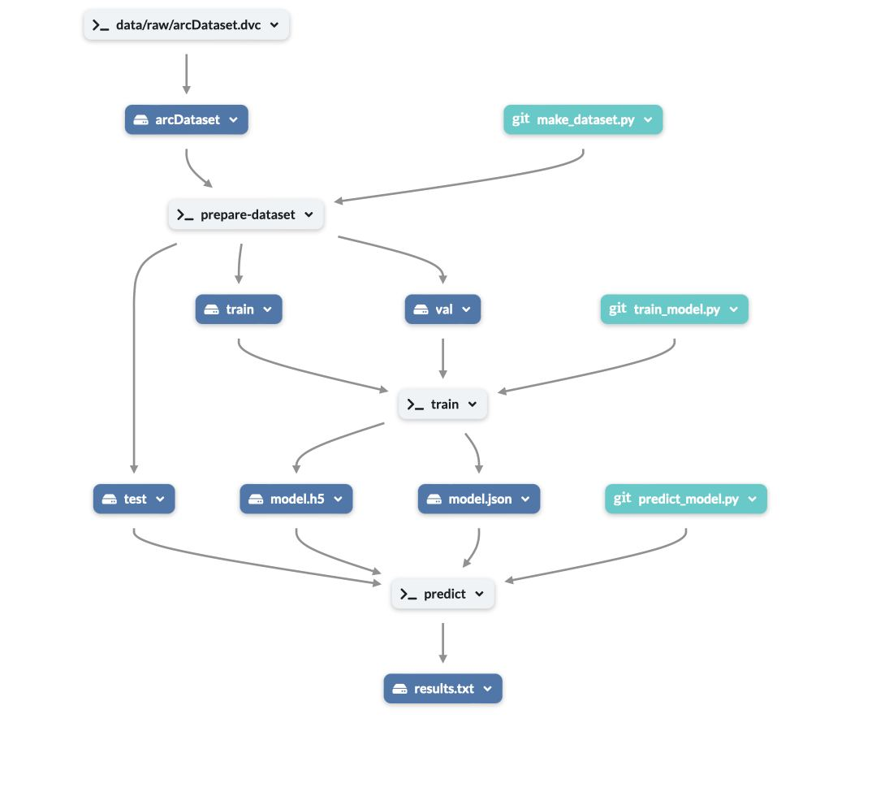
DVC: An Overview on the Pipeline

Slide 13
MLflow for Experiment Tracking
We have used MLFlow to track parameters and metrics relevant to our ML model. As a preliminary step, we have set as a tracking URI our DagsHub repository, so that we can visualize the results on that repository under the "Experiments" tab (or, alternatively, using the .mlflow URI).
Then, we have added the necessary code into the train_model.py and in the predict_model.py files, to track parameters and metrics.

Slide 14
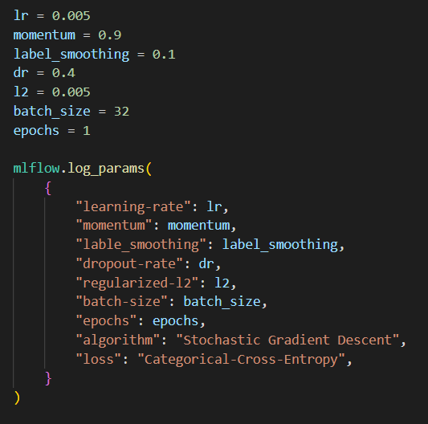
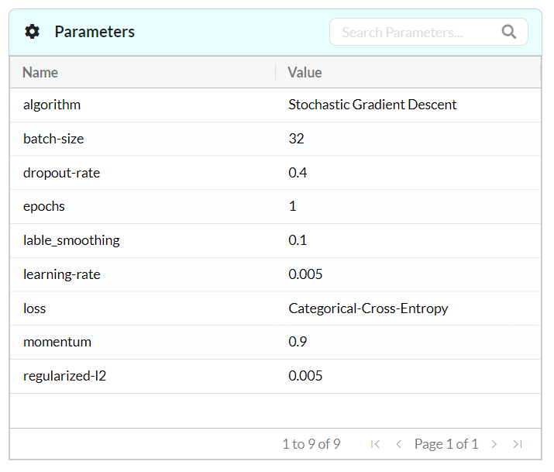
MLflow: Tracking Parameters
Below we report the relevant code and the visualization in MLFlow of our parameters and our metrics (derived from two different experiments).

Slide 15
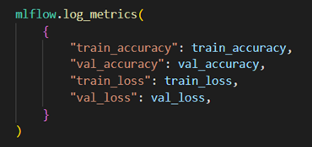
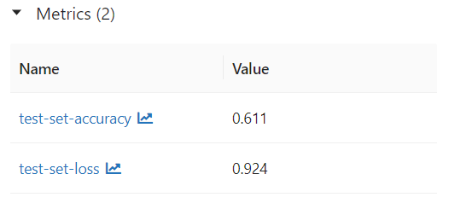
MLflow: Tracking Metrics

Slide 16
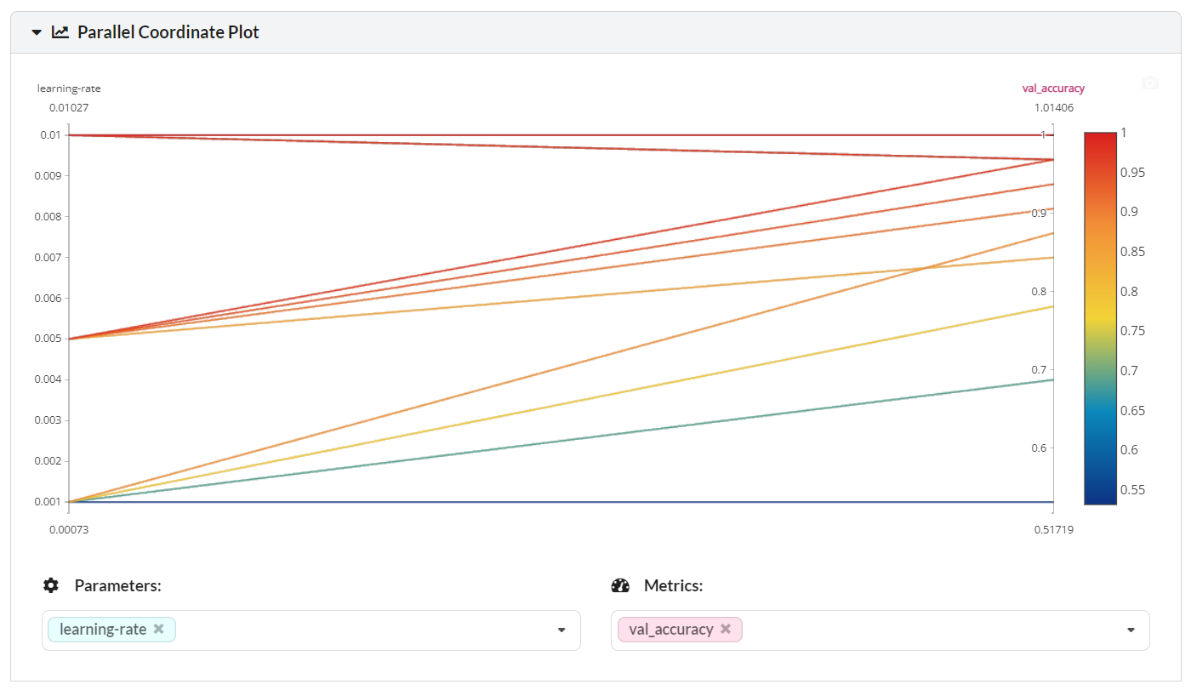
MLflow: Experiment Comparison

Slide 17
Additional Resources
DagsHub repo
.md file

Slide 18
Thank you for your attention!

